Slide 1
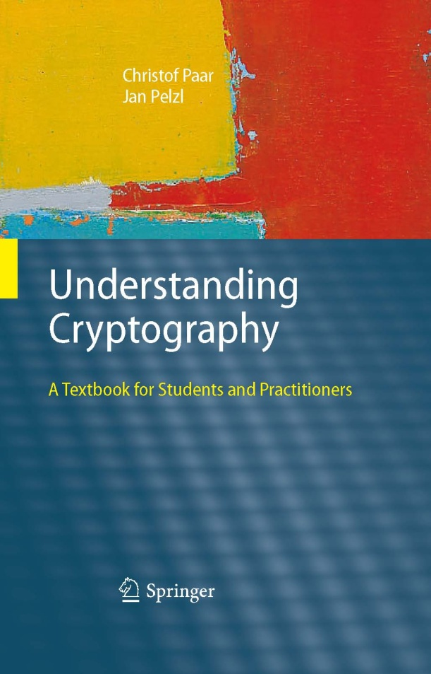
Chapter 7 – The RSA Cryptosystem
Notes:
1

Slide 2
Content of this Chapter
The RSA Cryptosystem
Implementation aspects
Finding Large Primes
RSA in Practice: Padding
Attacks and Countermeasures
Lessons Learned

Slide 3
Content of this Chapter
The RSA Cryptosystem
Implementation aspects
Finding Large Primes
RSA in Practice: Padding
Attacks and Countermeasures
Lessons Learned

Slide 4
The RSA Cryptosystem
Martin Hellman and Whitfield Diffie published their landmark public-key paper in 1976
Ronald Rivest, Adi Shamir and Leonard Adleman proposed the asymmetric RSA cryptosystem in1977
Until now, RSA is the most widely use asymmetric cryptosystem although elliptic curve cryptography (ECC) becomes increasingly popular
RSA is mainly used for two applications
Transport of (i.e., symmetric) keys (cf. Chptr 13 of Understanding Cryptography)
Digital signatures (cf. Chptr 10 of Understanding Cryptography)

Slide 5
Encryption and Decryption
RSA operations are done over the integer ring Z_{n} (i.e., arithmetic modulo n), where n = p * q, with p, q being large primes
Encryption and decryption are simply exponentiations in the ring
In practice x, y, n and d are very long integer numbers (≥ 2048 bits)
The security of the scheme relies on the fact that it is hard to derive the „private exponent“ d given the public-key (n, e)
Definition
Given the public key (n,e) = k_{pub} and the private key d = k_{pr} we write
y = e_{kpub}(x) ≡ x^{e} mod n
x = d_{kpr}(y) ≡ y^{d} mod n
where x, y ε Z_{n.}
We call e_{kpub}() the encryption and d_{kpr}() the decryption operation.

Slide 6
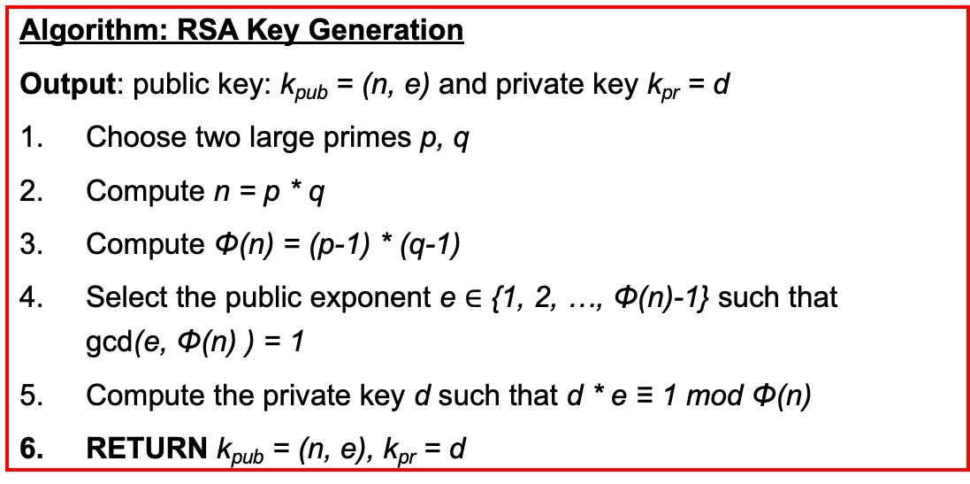
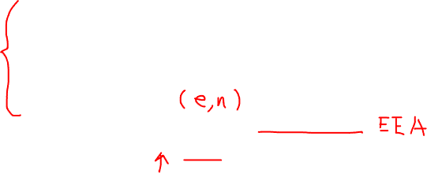
Key Generation
Like all asymmetric schemes, RSA has set-up phase during which the private and public keys are computed
Remarks:
Choosing two large, distinct primes p, q (in Step 1) is non-trivial
gcd(e, Φ(n)) = 1 ensures that e has an inverse and, thus, that there is always a private key d
Algorithm: RSA Key Generation
Output: public key: k_{pub} = (n, e) and private key k_{pr} = d
Choose two large primes p, q
Compute n = p * q
Compute Φ(n) = (p-1) * (q-1)
Select the public exponent e $∈$ {1, 2, …, Φ(n)-1} such that gcd(e, Φ(n) ) = 1
Compute the private key d such that d * e ≡ 1 mod Φ(n)
RETURN k_{pub} = (n, e), k_{pr} = d

Slide 7
Example: RSA with small numbers
ALICE
Message x = 4
y = x^{e} ≡ 4³ ≡ 31 mod 33
BOB
Choose p = 3 and q = 11
Compute n = p * q = 33
Φ(n) = (3-1) * (11-1) = 20
Choose e = 3
d ≡ e⁻¹ ≡7 mod 20
y^{d} = 31⁷ ≡ 4 = x mod 33
K_{pub} = (33,3)
y = 31

Slide 8
Content of this Chapter
The RSA Cryptosystem
Implementation aspects
Finding Large Primes
RSA in Practice: Padding
Attacks and Countermeasures
Lessons Learned

Slide 9
Implementation aspects
The RSA cryptosystem uses only one arithmetic operation (modular exponentiation) which makes it conceptually a simple asymmetric scheme
Even though conceptually simple, due to the use of very long numbers, RSA is orders of magnitude slower than symmetric schemes, e.g., DES, AES
When implementing RSA (esp. on a constrained device such as smartcards or cell phones) close attention has to be paid to the correct choice of arithmetic algorithms
The square-and-multiply algorithm allows fast exponentiation, even with very long numbers…

Slide 10
Square-and-Multiply
Basic principle: Scan exponent bits from left to right and square/multiply operand accordingly
Rule: Square in every iteration (Step 3) and multiply current result by x if the exponent bit h_{i} = 1 (Step 5)
Modulo reduction after each step keeps the operand y small
Algorithm: Square-and-Multiply for x^{H} mod n
Input: Exponent H, base element x, Modulus n
Output: y = x^{H} mod n
Determine binary representation H = (h_{t}, h_{t-1}, ..., h₀)₂
FOR i = t-1 TO 0
y = y² mod n
IF h_{i} = 1 THEN
y = y * x mod n
RETURN y

Slide 11

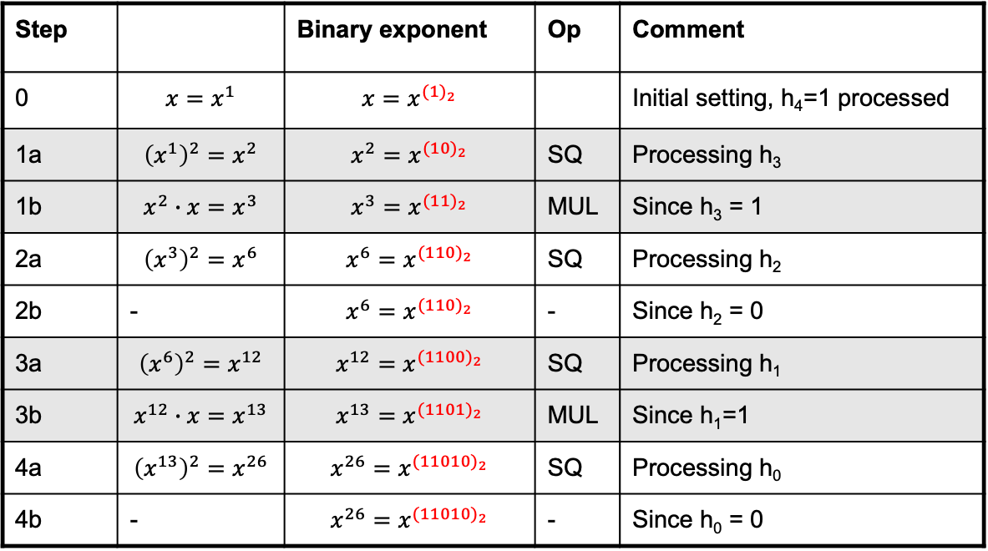
Example: Square-and-Multiply
Computes ${x^{26}=x}^{{(11010)}_{2}}=x^{{{(h}_{4}h_{3}h_{2}h_{1}h_{0})}_{2}}$ without modulo reduction
Observe how the exponent evolves into ${x^{26}=x}^{{(11010)}_{2}}$
Step |  | Binary exponent | Op | Comment
0 | $$x=x^{1}$$ | $$x=x^{{(1)}_{2}}$$ |  | Initial setting, h₄=1 processed
1a | $${{\left(x^{1}\right)}^{2}=x}^{2}$$ | $${x^{2}=x}^{{(10)}_{2}}$$ | SQ | Processing h₃
1b | $$x^{2}∙x=x^{3}$$ | $${x^{3}=x}^{{(11)}_{2}}$$ | MUL | Since h₃ = 1
2a | $${{\left(x^{3}\right)}^{2}=x}^{6}$$ | $$x^{6}=x^{{(110)}_{2}}$$ | SQ | Processing h₂
2b | - | $$x^{6}=x^{{(110)}_{2}}$$ | - | Since h₂ = 0
3a | $${{\left(x^{6}\right)}^{2}=x}^{12}$$ | $$x^{12}=x^{{(1100)}_{2}}$$ | SQ | Processing h₁
3b | $$x^{12}∙x=x^{13}$$ | $$x^{13}=x^{{(1101)}_{2}}$$ | MUL | Since h₁=1
4a | $${{\left(x^{13}\right)}^{2}=x}^{26}$$ | $${x^{26}=x}^{{(11010)}_{2}}$$ | SQ | Processing h₀
4b | - | $${x^{26}=x}^{{(11010)}_{2}}$$ | - | Since h₀ = 0

Slide 12
Complexity of Square-and-Multiply Alg.
The square-and-multiply algorithm has a logarithmic complexity, i.e., its run time is proportional to the bit length (rather than the absolute value) of the exponent
Given an exponent with t+1 bits H = (h_{t},h_{t-1}, ..., h₀)₂ with h_{t} = 1, we need the following operations
# Squarings = t
Average # multiplications = 0.5 t
Total complexity: #SQ + #MUL = 1.5 t
Exponents are often randomly chosen, so 1.5 t is a good estimate for the average number of operations
Note that each squaring and each multiplication is an operation with very long numbers, e.g., 2048 bit integers.

Slide 13
Speed-Up Techniques
Modular exponentiation is computationally intensive
Even with the square-and-multiply algorithm, RSA can be quite slow on constrained devices such as smart cards
Some important tricks:
Short public exponent e
Chinese Remainder Theorem (CRT)
Exponentiation with pre-computation (not covered here)

Slide 14
Fast encryption with small public exponent
Choosing a small public exponent e does not weaken the security of RSA
A small public exponent improves the speed of the RSA encryption significantly
This is a commonly used trick (e.g., SSL/TLS, etc.) and makes RSA the fastest asymmetric scheme with regard to encryption!
Public Key | e as binary string | #MUL + #SQ
2¹+1 = 3 | (11)₂ | 1 + 1 = 2
2⁴+1 = 17 | (1 0001)₂ | 4 + 1 = 5
2¹⁶ + 1 | (1 0000 0000 0000 0001)₂ | 16 + 1 = 17

Slide 15
Fast decryption with CRT
Choosing a small private key d results in security weaknesses!
In fact, d must have at least 0.3t bits, where t is the bit length of the modulus n
However, the Chinese Remainder Theorem (CRT) can be used to (somewhat) accelerate exponentiation with the private key d
Based on the CRT we can replace the computation of
y^{d mod Φ(n)} mod n
by two computations
y^{d} ^{mod (p-1)} mod p and y^{d mod (q-1)} mod q
where q and p are “small” compared to n

Slide 16
Basic principle of CRT-based exponentiation
Problem Domain
y
y^{d} mod n
y_{p}
y_{p}^{d mod (p-1)} mod p
CRT Domain
y_{q}
y_{q}^{d mod (q-1)} mod q
CRT involves three distinct steps
(1) Transformation of operand into the CRT domain
(2) Modular exponentiation in the CRT domain
(3) Inverse transformation into the problem domain
These steps are equivalent to one modular exponentiation in the problem domain

Slide 17
CRT: Step 1 – Transformation
Transformation into the CRT domain requires the knowledge of p and q
p and q are only known to the owner of the private key, hence CRT cannot be applied to speed up encryption
The transformation computes (y_{p}, y_{q}) which is the representation of y in the CRT domain. They can be found easily by computing
y_{p} ≡ y mod p and y_{q} ≡ y mod q

Slide 18
CRT: Step 2 – Exponentiation
Given d_{p} and d_{q} such that
d_{p} ≡ d mod (p-1) and d_{q} ≡ d mod (q-1)
one exponentiation in the problem domain requires two exponentiations in the CRT domain
x_{p} ≡ y_{p}^{dp} mod p and x_{q} ≡ y_{q}^{dq} mod q
In practice, p and q are chosen to have half the bit length of n, i.e., |p| ≈ |q| ≈ |n|/2

Slide 19
CRT: Step 3 – Inverse Transformation
Inverse transformation requires modular inversion twice, which is computationally expensive
c_{p} ≡ q⁻¹ mod p and c_{q} ≡ p⁻¹ mod q
Inverse transformation assembles y_{p}, y_{q} to the final result y mod n in the problem domain
x ≡ [ q * c_{p} ] * x_{p} + [ p * c_{q} ] * x_{q} mod n
The primes p and q typically change infrequently, therefore the cost of inversion can be neglected because the two expresssions [ q * c_{p} ] and [ p * c_{q} ] can be precomputed and stored

Slide 20
Complexity of CRT
We ignore the transformation and inverse transformation steps since their costs can be neglected under reasonable assumptions
Assuming that n has t+1 bits, both p and q are about t/2 bits long
The complexity is determined by the two exponentiations in the CRT domain. The operands are only t/2 bits long. For the exponentiations we use the square-and-multiply algorithm:
# squarings (one exp.): #SQ = 0.5 t
# aver. multiplications (one exp.): #MUL = 0.25t
Total complexity: 2 * (#MUL + #SQ) = 1.5t
This looks the same as regular exponentations, but since the operands have half the bit length compared to regular exponent., each operation (i.e., multipl. and squaring) is 4 times faster!
Hence CRT is 4 times faster than straightforward exponentiation

Slide 21
Content of this Chapter
The RSA Cryptosystem
Implementation aspects
Finding Large Primes
RSA in Practice: Padding
Attacks and Countermeasures
Lessons Learned

Slide 22
Finding Large Primes
Generating keys for RSA requires finding two large primes p and q such that n = p * q is sufficiently large
The size of p and q is typically half the size of the desired size of n
To find primes, random integers are generated and tested for primality:
The random number generator (RNG) should be non-predictable otherwise an attacker could guess the factorization of n
p'
p' is prime
OR
p' is composite
RNG
Primality Test
candidate
prime
a

Slide 23
Primality Tests
Factoring p and q to test for primality is typically not feasible
However, we are not interested in the factorization, we only want to know whether p and q are composite
Typical primality tests are probabilistic, i.e., they are not 100% accurate but their output is correct with very high probability
A probabilistic test has two outputs:
“p’ is composite” – always true
“p’ is a prime” – only true with a certain probability
Among the well-known primality tests are the following
Fermat Primality-Test
Miller-Rabin Primality-Test

Slide 24
Fermat Primality-Test
Basic idea: Fermat‘s Little Theorem holds for all primes, i.e., if a number p‘ is found for which a^{p‘-1} ≡ 1 mod p‘, it is not a prime
For certain numbers (“Carchimchael numbers”) this test returns “p‘ is likely a prime” often – although these numbers are composite
Therefore, the Miller-Rabin Test is preferred
Algorithm: Fermat Primality-Test
Input: Prime candidate p‘, security parameter s
Output: p‘ is composite or p‘ is likely a prime
FOR i = 1 TO s
choose random a ε {2,3, ..., p‘-2}
IF a^{p‘-1} ≡ 1 mod p’ THEN
RETURN p‘ is composite
RETURN p‘ is likely a prime

Slide 25
Theorem for Miller-Rabin‘s test
The more powerful Miller-Rabin Test is based on the following theorem
This theorem can be turned into an algorithm
Theorem
Given the decomposition of an odd prime candidate p‘
p‘ – 1 = 2^{u *} r
where r is odd. If we can find an integer a such that
a^{r} ≡ 1 mod p‘ and a^{r2j} ≡ p‘ - 1 mod p‘
For all j = {0,1, ..., u-1}, then p‘ is composite.
Otherwise it is probably a prime.

Slide 26
Miller-Rabin Primality-Test
Algorithm: Miller-Rabin Primality-Test
Input: Prime candidate p‘ with p‘-1 = 2^{u * r} security parameter s
Output: „p‘ is composite“ or „p‘ is likely a prime“
FOR i = 1 TO s
choose random a ε {2,3, ..., p‘-2}
z ≡ a^{r} mod p’
IF z ≠ 1 AND z ≠ p’-1 THEN
FOR j = 1 TO u-1
z ≡ z² mod p’
IF z = 1 THEN
RETURN „p‘ is composite“
IF z ≠ p‘-1 THEN
RETURN „p‘ is composite“
RETURN „p‘ is likely a prime“

Slide 27
Content of this Chapter
The RSA Cryptosystem
Implementation aspects
Finding Large Primes
RSA in Practice: Padding
Attacks and Countermeasures
Lessons Learned

Slide 28
Textbook is insecure
Textbook RSA encryption is deterministic.
Small public exponents e and small plaintext x might be subject to attacks if no padding is used.
Textbook RSA is malleable.

Slide 29
RSA encryption in practice
Never use textbook RSA.
RSA in practice:
Main questions:
How should the preprocessing be done?
Can we argue about security of resulting system?
msg
key
Preprocessing
RSA
ciphertext
Notes:
ISO standard is the “full domain hash” method discussed in lecture.

Slide 30
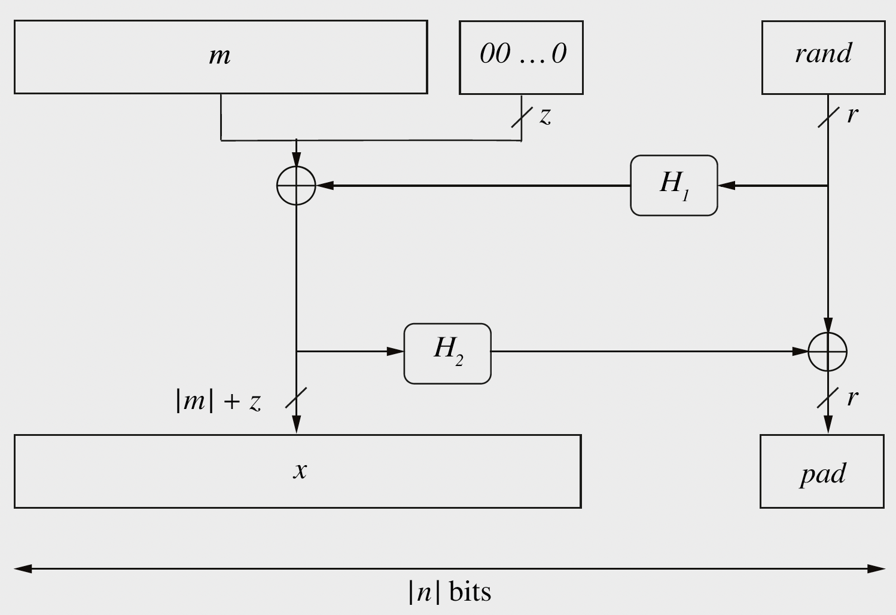
Encryption Using Optimal Asymmetric Encryption Padding (O A E P)

Slide 31
Content of this Chapter
The RSA Cryptosystem
Implementation aspects
Finding Large Primes
RSA in Practice: Padding
Attacks and Countermeasures
Lessons Learned

Slide 32
Attacks and Countermeasures 1/3
There are two distinct types of attacks on cryptosystems
Analytical attacks try to break the mathematical structure of the underlying problem of RSA
Implementation attacks try to attack a real-world implementation by exploiting inherent weaknesses in the way RSA is realized in software or hardware

Slide 33
Attacks and Countermeasures 2/3
RSA is typically exposed to these analytical attack vectors
Mathematical attacks
The best known attack is factoring of n in order to obtain Φ(n)
Can be prevented using a sufficiently large modulus n
The current factoring record is 664 bits. Thus, it is recommended that n should have a bit length between 1024 and 3072 bits
Protocol attacks
Exploit the malleability of RSA, i.e., the property that a ciphertext can be transformed into another ciphertext which decrypts to a related plaintext – without knowing the private key
Can be prevented by proper padding

Slide 34
Attacks and Countermeasures 3/3
Implementation attacks can be one of the following
Side-channel analysis
Exploit physical leakage of RSA implementation (e.g., power consumption, EM emanation, etc.)
Fault-injection attacks
Inducing faults in the device while CRT is executed can lead to a complete leakage of the private key
More on all attacks can be found in Section 7.8 of Understanding Cryptography

Slide 35
Content of this Chapter
The RSA Cryptosystem
Implementation aspects
Finding Large Primes
Attacks and Countermeasures
Lessons Learned

Slide 36
Lessons Learned
RSA is the most widely used public-key cryptosystem
RSA is mainly used for key transport and digital signatures
The public key e can be a short integer, the private key d needs to have the full length of the modulus n
RSA relies on the fact that it is hard to factorize n
Currently 1024-bit cannot be factored, but progress in factorization could bring this into reach within 10-15 years. Hence, RSA with a 2048 or 3076 bit modulus should be used for long-term security
A naïve implementation of RSA allows several attacks, and in practice RSA should be used together with padding

